Slide 1
Computer vision and deep learning
Lecture 5

Slide 2
Today’s agenda
Training a neural network
Data preprocessing
Initialization
Batch Normalization
Regularization techniques
Optimization algorithms
Bias and variance
Hyper-parameter tuning

Slide 3
Train, dev and test sets
Training set
Used to train the model, determines what the network learns
Development (dev) set or validation set
Used to evaluate the performance of your models and determine which ones work best
Test set
Used to get an unbiased estimate of the final performance of the model
Sometimes is might be ok to not have a test set (only train and dev sets)

Slide 4
How to split your data into train/dev/test set?
Before deep learning, when available data was relatively limited (e.g. 10000 images)
70 % train
30 % dev
7000 train, 3000 dev
60 % train
20% test
20% dev
6000 train, 2000 dev,
2000 test

Slide 5
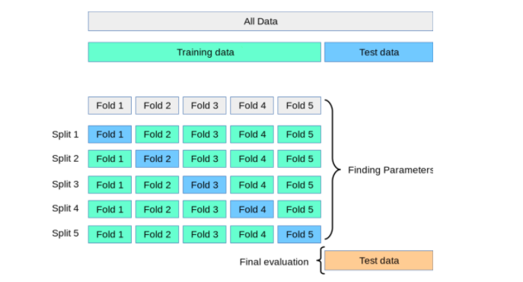
K-fold validation

Slide 6
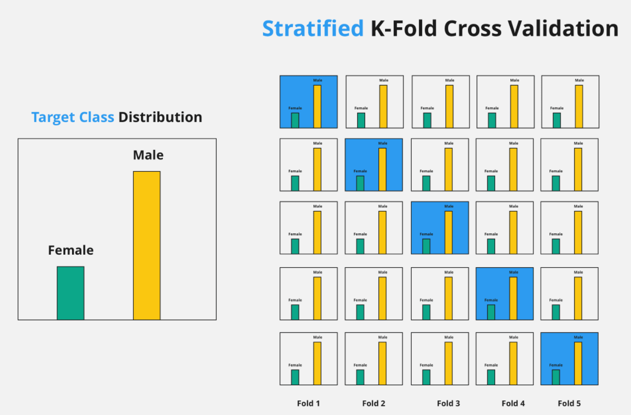
Stratified k-fold validation

Slide 7
How to split your data into train/dev/test set?
Large scale datasets
ImageNet > 14 million images
VGGFace 2 > 3.3 million images
JFT > 300 million images
E.g. 1 million images
980000 train set, 10000 dev set, 10000 test set -> 98% train, 1% dev, 1% test
E.g. 4 million images
3980000 train set, 10000 dev set, 10000 test set -> 99.5% train, 0.25% dev, 0.25% test

Slide 8
Bias and Variance
Bias: difference the average prediction of our model and the correct value which we are trying to predict
Variance: the variability of model prediction/ the spread of the predictions

Slide 9
Bias and Variance
High bias: under-fitting the data
Model pays little attention to training data and over simplifies the problem
High variance: over-fitting the data
Model performs well on the training set, but not on test set

Slide 10
Dealing with variance and bias problems
High bias?

Slide 11
Dealing with variance and bias problems
High bias? (train set performance)
Try a more complex model/different NN architecture
Train longer
High variance?

Slide 12
Dealing with variance and bias problems
High bias? (train set performance)
Try a more complex model/different NN architecture
Train longer
High variance? (validation set performance)
Add more data
Add more regularization techniques
Try a different NN architecture

Slide 13
Data pre-processing

Slide 14
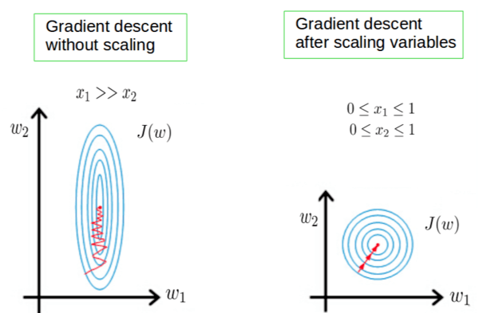
Importance of feature scaling

Slide 15
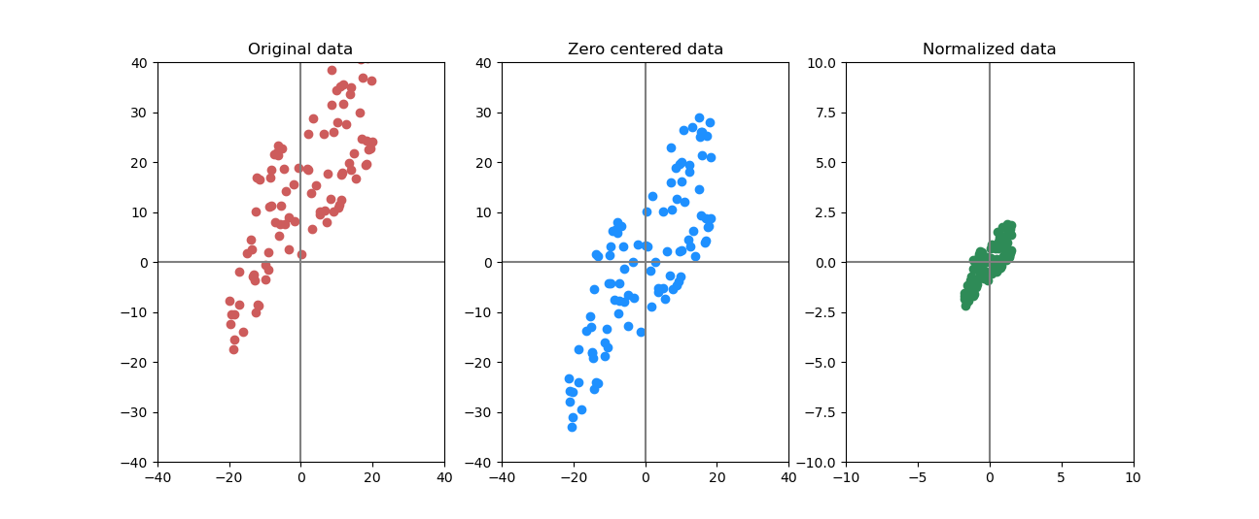
Mean subtraction, scaling
X
X -= np.mean(X, axis=0)
X /= np.std(X, axis=0)

Slide 16
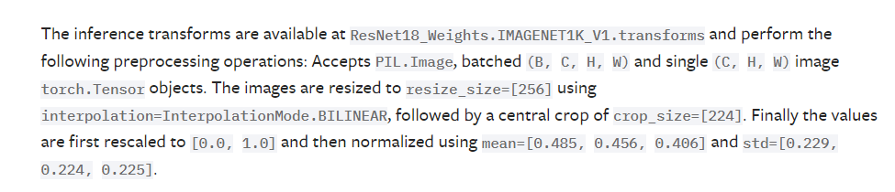
Pre-processing for Images
Zero center: subtract the mean across every individual feature in the data
Mean image
Mean across each channel

Slide 17
Exponential weighted averages

Slide 18
Exponential weighted averages
https://colab.research.google.com/drive/1CTSctxtN1JDvGZOswpLlG9ZkC4-s0ym2?usp=sharing

Slide 19
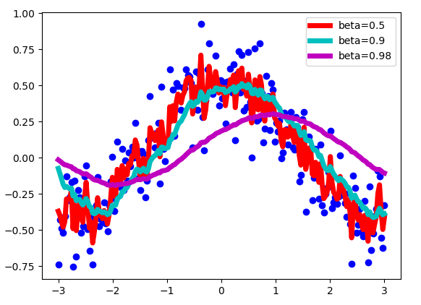
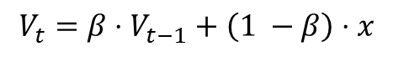
Exponential weighted averages
$$V_{t}=β⋅V_{t−1}+\left(1 −β\right)⋅x$$
https://towardsdatascience.com/stochastic-gradient-descent-with-momentum-a84097641a5d

Slide 20
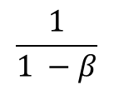
Exponential weighted averages
V_{t} approximates over:
$$\frac{1}{1 −β}$$
samples
https://towardsdatascience.com/stochastic-gradient-descent-with-momentum-a84097641a5d

Slide 21
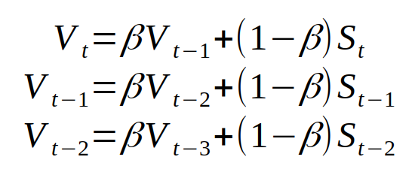
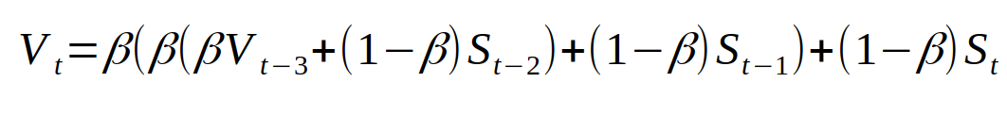
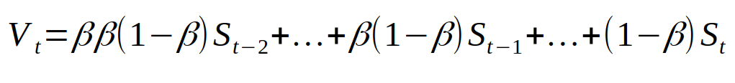
Exponential weighted average
The coefficients add up to approximately 1

Slide 22
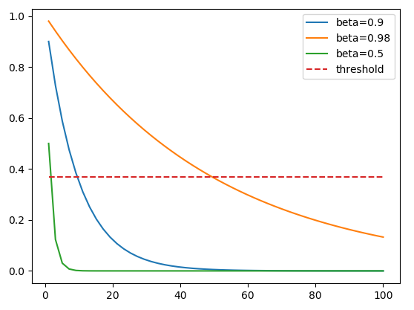
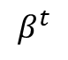
Exponential weighted average
Forgetting: threshold 1/e
(1 – ε)^{1/ ε} = 1/e
1/e
$$β^{t}$$
https://www.youtube.com/watch?v=lAq96T8FkTw intuition for approximation

Slide 23
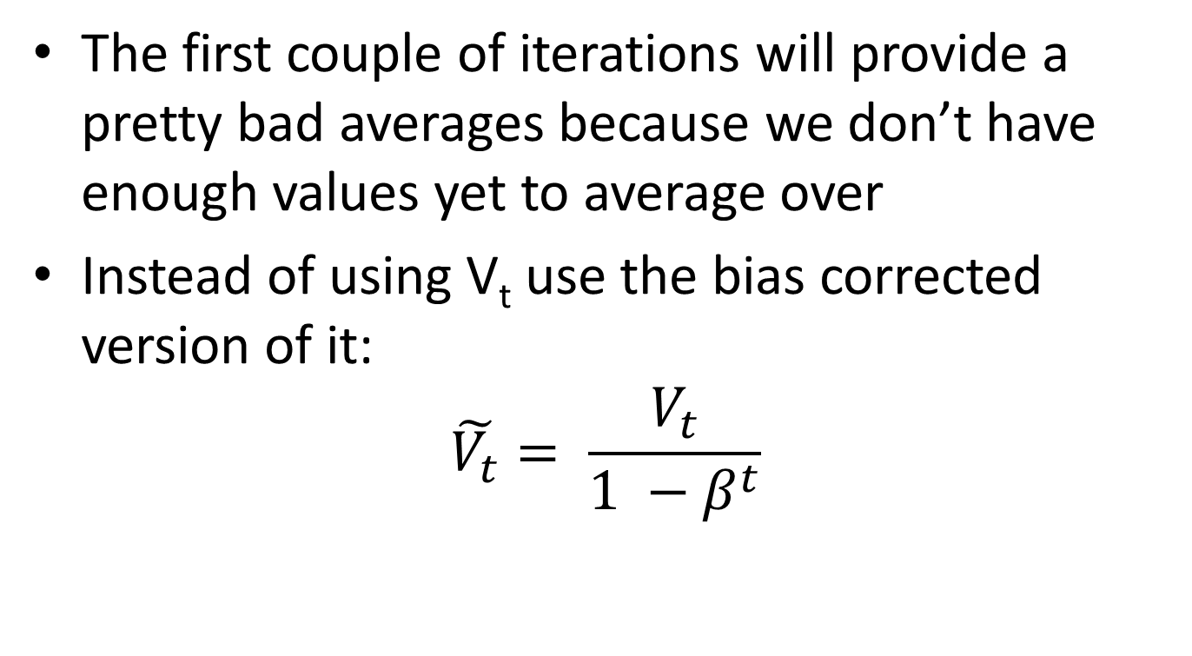
Exponential weighted average Bias correction
The first couple of iterations will provide a pretty bad averages because we don’t have enough values yet to average over
Instead of using V_{t} use the bias corrected version of it:
$$\tilde{V_{t}}= \frac{V_{t}}{1 −β^{t}}$$
https://www.youtube.com/watch?v=lAq96T8FkTw
https://www.youtube.com/watch?v=NxTFlzBjS-4
https://www.youtube.com/watch?v=lWzo8CajF5s – bias correction

Slide 24
Training a neural network
Weights initialization

Slide 25
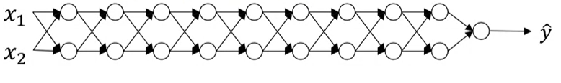
Vanishing and exploding gradients
Image source: https://www.coursera.org/learn/deep-neural-network/lecture/C9iQO/vanishing-exploding-gradients

Slide 26
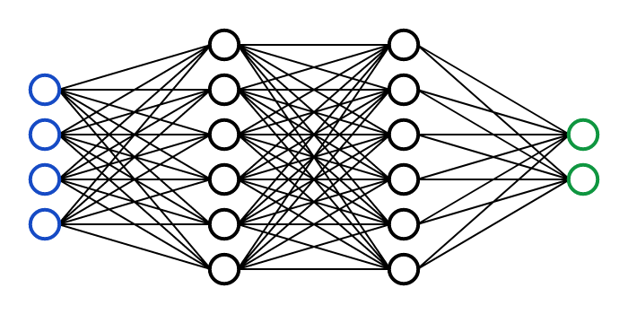

How not to initialize: zero weights
No symmetry breaking

Slide 27
Weight initialization Example credit: Andrew Karpathy
https://colab.research.google.com/drive/1CvCXZIevs6MvQnldyG2UHZevG0bKaeiu?usp=sharing

Slide 28
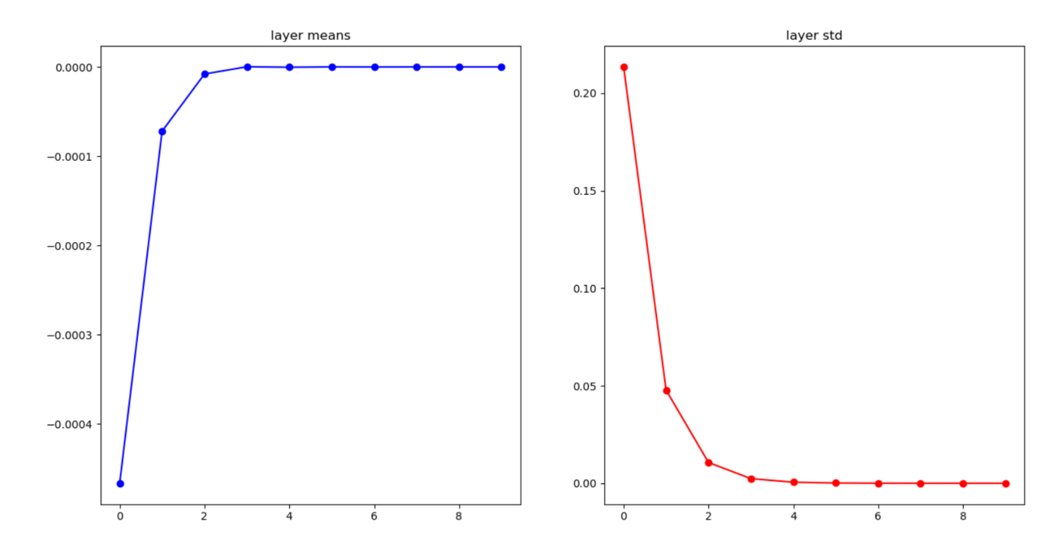
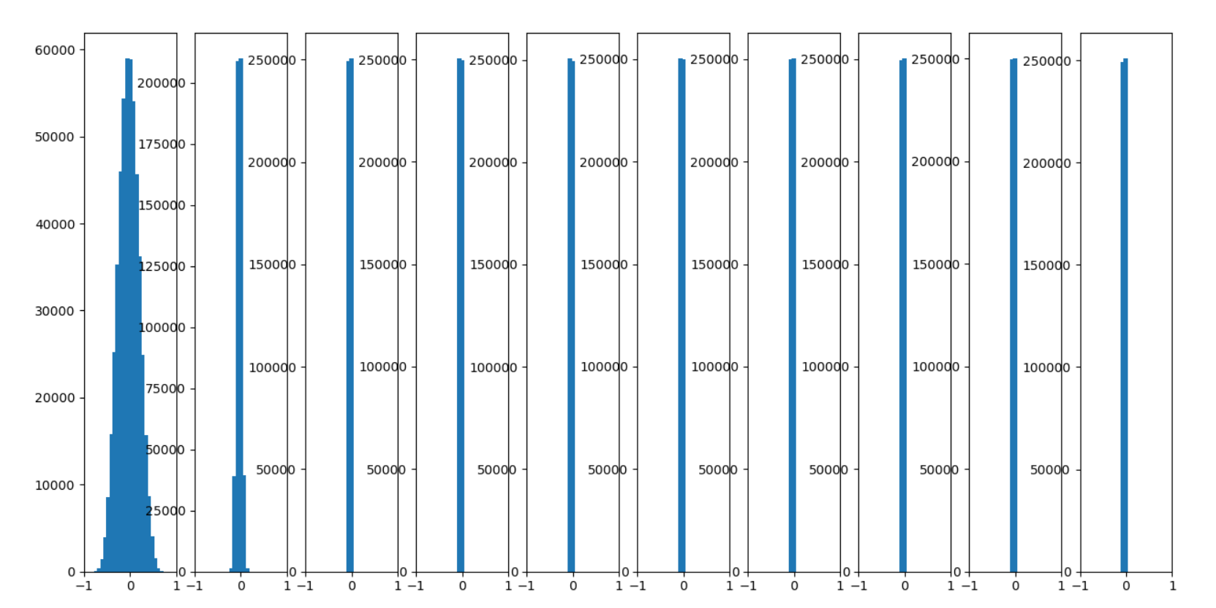
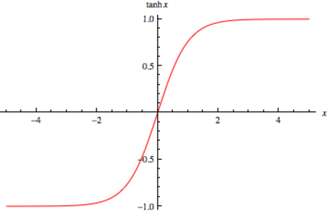
W = np.random.randn(in, out)*0.01
input layer had mean -0.001449 and stddev 0.999223
hidden layer 0 had mean 0.000289 and stddev 0.213667
hidden layer 1 had mean -0.000064 and stddev 0.047754
hidden layer 2 had mean -0.000001 and stddev 0.010667
hidden layer 3 had mean -0.000003 and stddev 0.002391
hidden layer 4 had mean 0.000000 and stddev 0.000535
hidden layer 5 had mean -0.000000 and stddev 0.000119
hidden layer 6 had mean 0.000000 and stddev 0.000027
hidden layer 7 had mean -0.000000 and stddev 0.000006
hidden layer 8 had mean 0.000000 and stddev 0.000001
hidden layer 9 had mean 0.000000 and stddev 0.000000
tanh activation

Slide 29
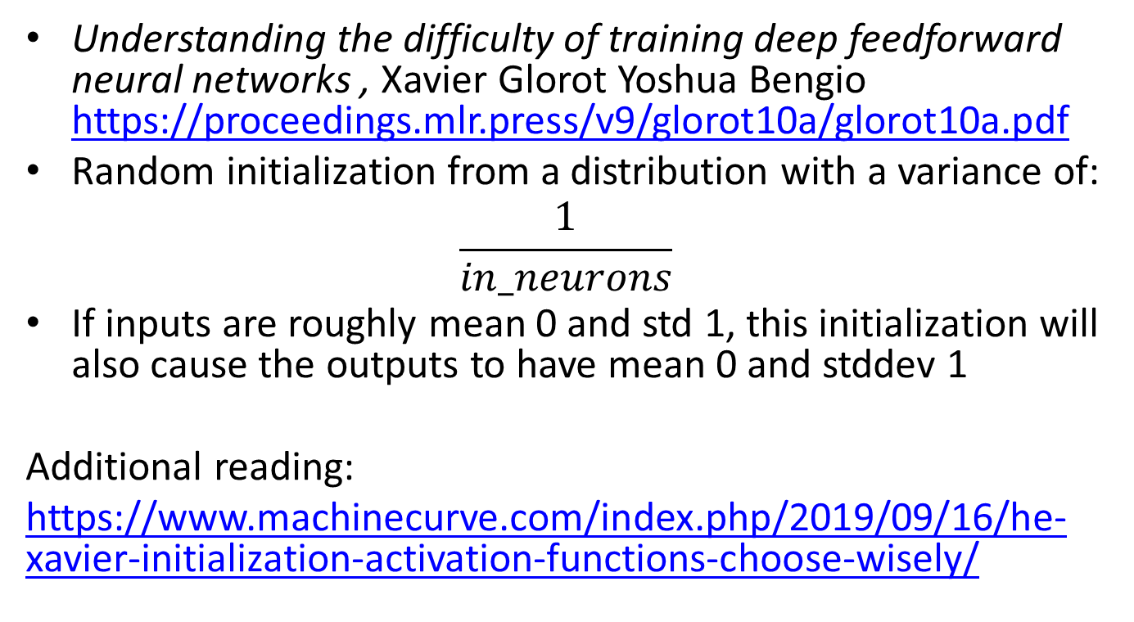
Xavier initialization
Understanding the difficulty of training deep feedforward neural networks , Xavier Glorot Yoshua Bengio https://proceedings.mlr.press/v9/glorot10a/glorot10a.pdf
Random initialization from a distribution with a variance of:
$$\frac{1}{in_neurons}$$
If inputs are roughly mean 0 and std 1, this initialization will also cause the outputs to have mean 0 and stddev 1
Additional reading:
https://www.machinecurve.com/index.php/2019/09/16/he-xavier-initialization-activation-functions-choose-wisely/

Slide 30
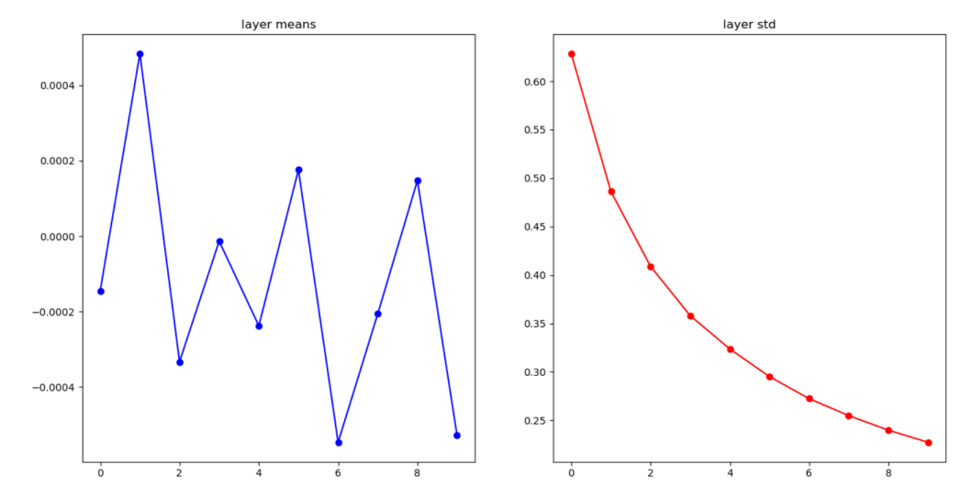
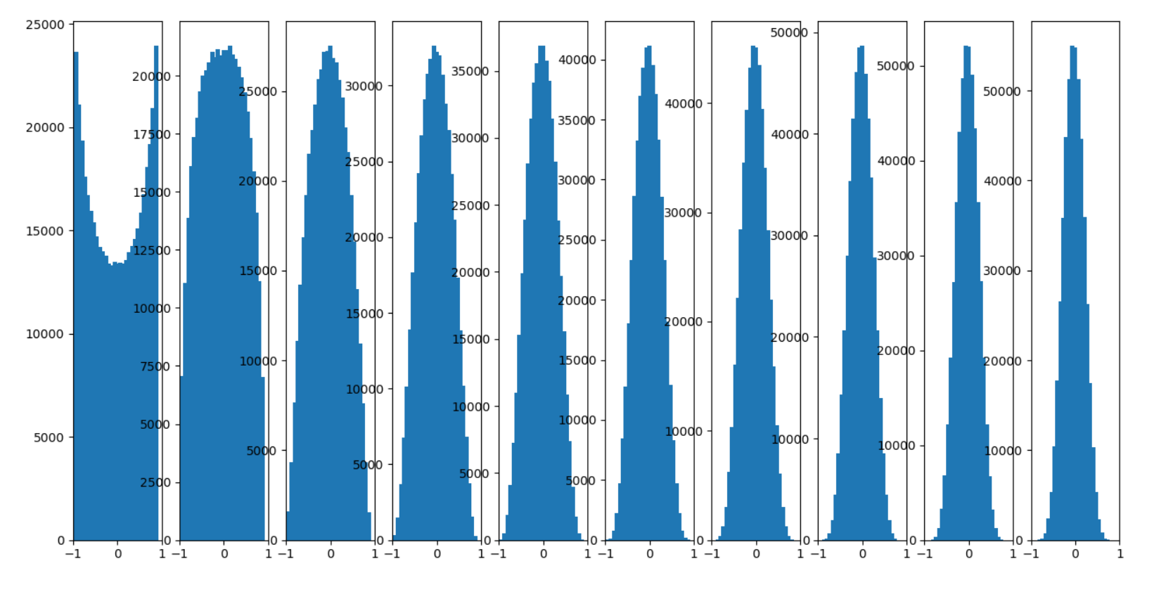
Xavier initialization
W = np.random.randn(in, out)/np.sqrt(in)
hidden layer 0 had mean -0.000145 and stddev 0.628485
hidden layer 1 had mean 0.000485 and stddev 0.486178
hidden layer 2 had mean -0.000333 and stddev 0.408851
hidden layer 3 had mean -0.000013 and stddev 0.358011
hidden layer 4 had mean -0.000238 and stddev 0.323565
hidden layer 5 had mean 0.000176 and stddev 0.295040
hidden layer 6 had mean -0.000547 and stddev 0.272295
hidden layer 7 had mean -0.000206 and stddev 0.254713
hidden layer 8 had mean 0.000148 and stddev 0.239710
hidden layer 9 had mean -0.000529 and stddev 0.227241
tanh activation

Slide 31
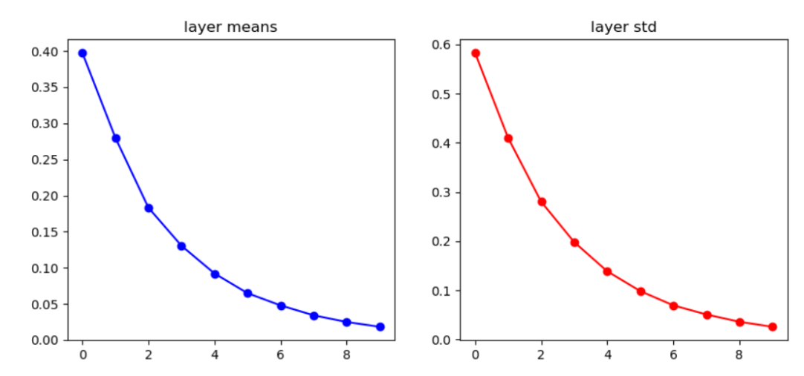
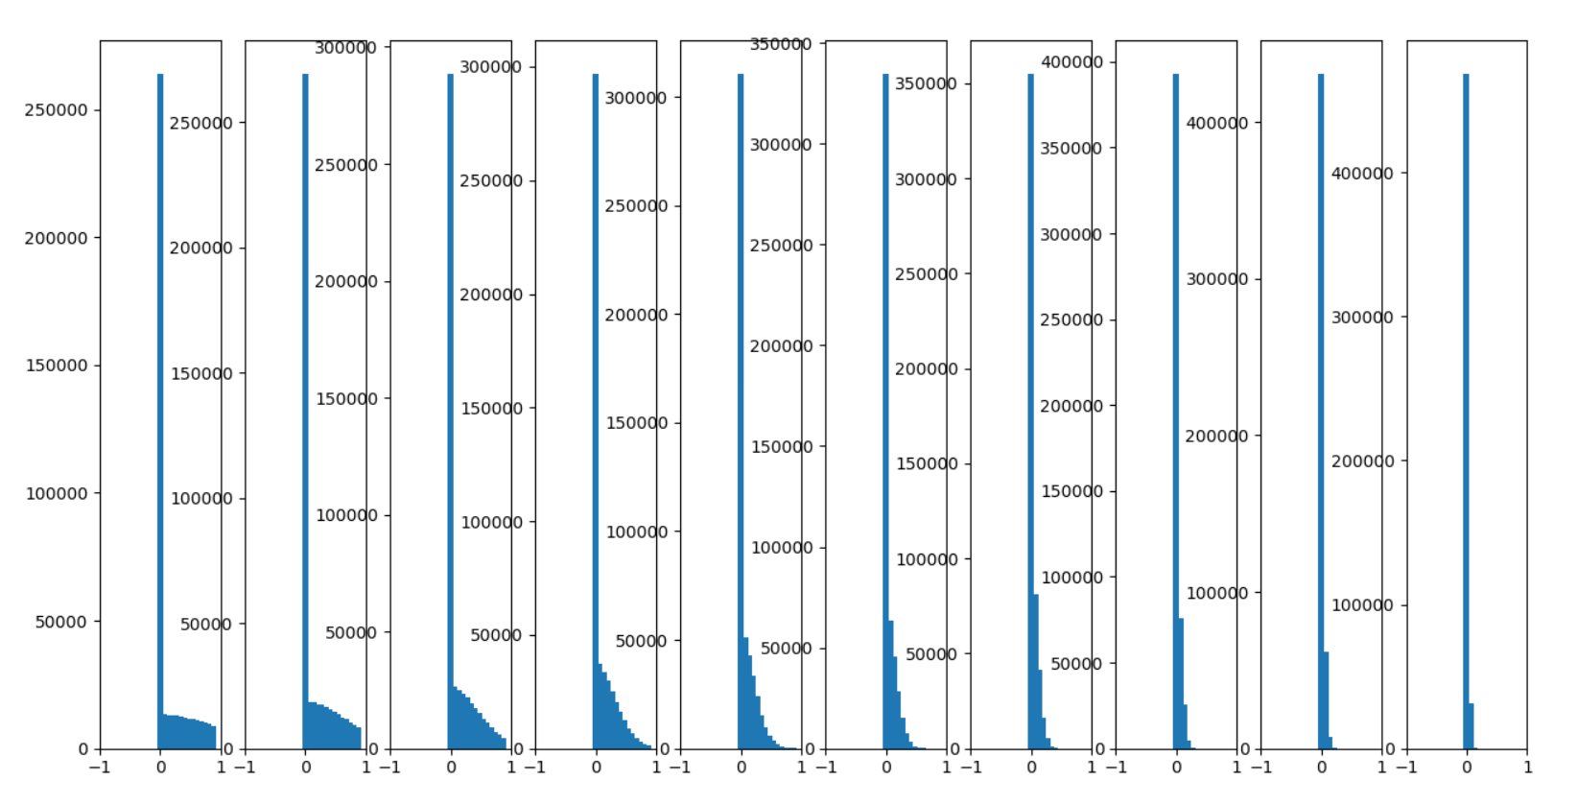
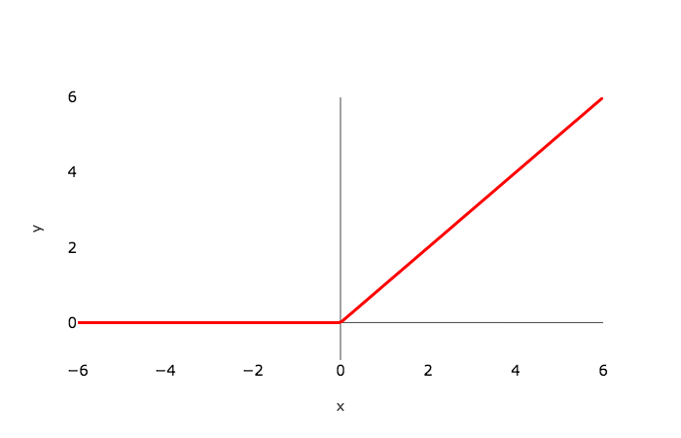
Xavier initialization
W = np.random.randn(in, out)/np.sqrt(in)
input layer had mean 0.000422 and stddev 1.000922
hidden layer 0 had mean 0.397685 and stddev 0.583384
hidden layer 1 had mean 0.280004 and stddev 0.410386
hidden layer 2 had mean 0.183151 and stddev 0.280291
hidden layer 3 had mean 0.130450 and stddev 0.198090
hidden layer 4 had mean 0.092056 and stddev 0.138666
hidden layer 5 had mean 0.064787 and stddev 0.098349
hidden layer 6 had mean 0.047867 and stddev 0.069325
hidden layer 7 had mean 0.034165 and stddev 0.050724
hidden layer 8 had mean 0.024928 and stddev 0.035902
hidden layer 9 had mean 0.018272 and stddev 0.025658
relu activation

Slide 32
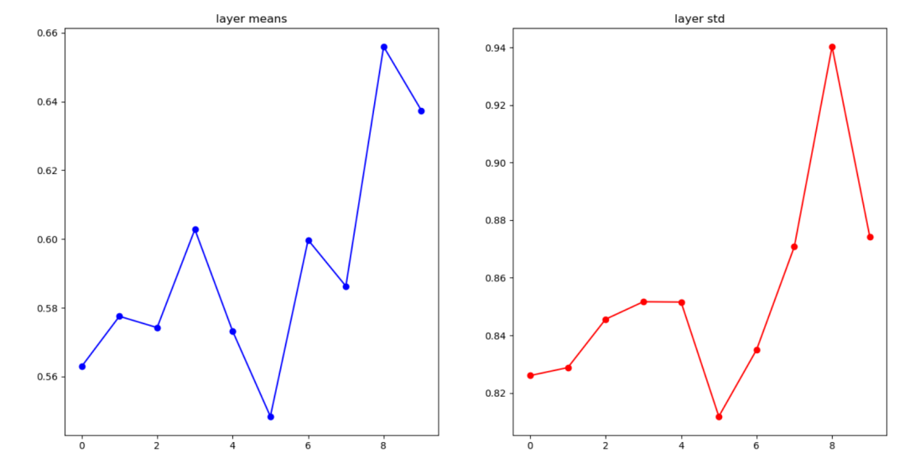
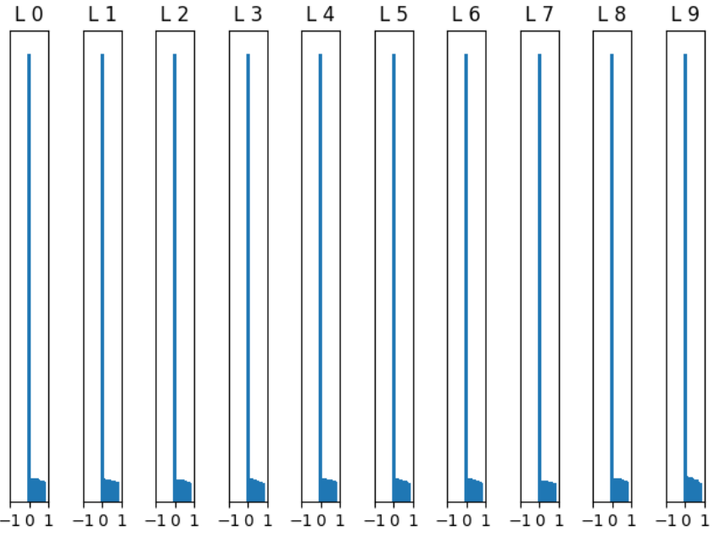
He initialization
W = np.random.randn(in, out)/np.sqrt(in/2)
input layer had mean -0.001160 and stddev 1.000333
hidden layer 0 had mean 0.562934 and stddev 0.826029
hidden layer 1 had mean 0.577537 and stddev 0.828810
hidden layer 2 had mean 0.574250 and stddev 0.845599
hidden layer 3 had mean 0.602799 and stddev 0.851682
hidden layer 4 had mean 0.573220 and stddev 0.851573
hidden layer 5 had mean 0.548410 and stddev 0.811833
hidden layer 6 had mean 0.599740 and stddev 0.834997
hidden layer 7 had mean 0.586302 and stddev 0.870794
hidden layer 8 had mean 0.655965 and stddev 0.940311
hidden layer 9 had mean 0.637412 and stddev 0.874220
relu activation

Slide 33
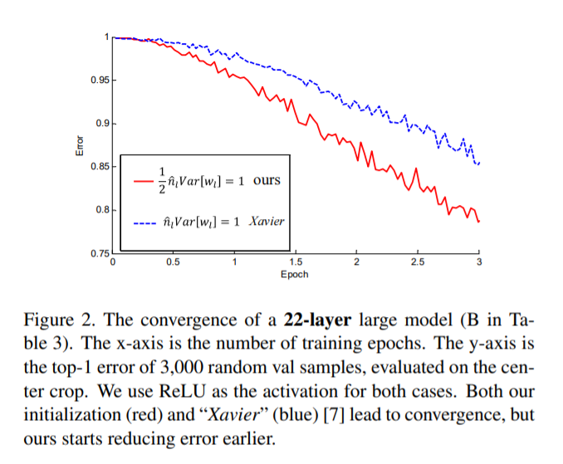
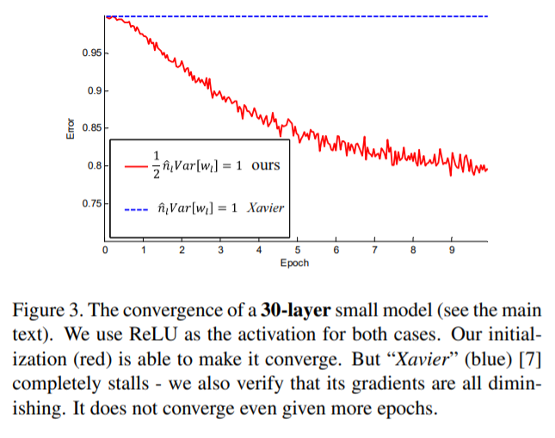
“Delving Deep into Rectifiers: Surpassing Human-Level Performance on ImageNet Classification” https://arxiv.org/pdf/1502.01852.pdf

Slide 34
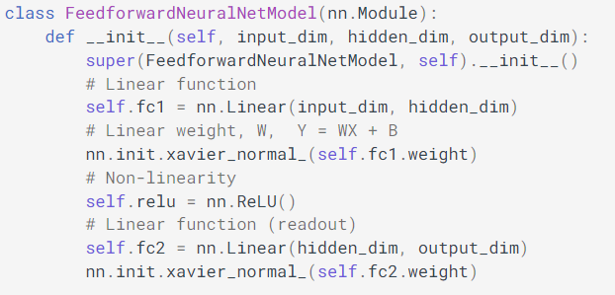
Torch initialization
torch.nn.init.zeros_(tensor)
torch.nn.init.xavier_normal_(tensor, gain=1.0)
torch.nn.init.sparse_(tensor, sparsity, std=0.01)
torch.nn.init.kaiming_normal_(tensor, a=0, mode='fan_in', nonlinearity='leaky_relu')
https://www.deeplearningwizard.com/deep_learning/boosting_models_pytorch/weight_initialization_activation_functions /

Slide 35
Batch normalization
Compute mean and variance across each dimension
Normalize
D1
D2
D3
N
D

Slide 36
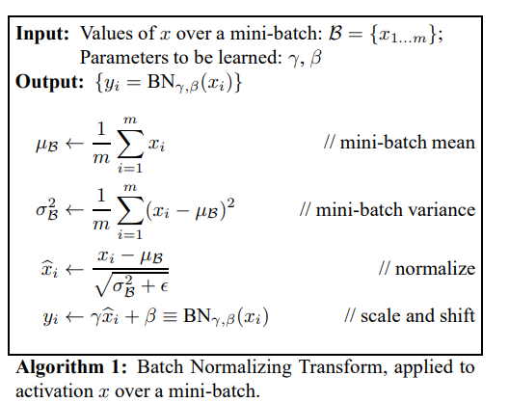
Batch normalization
Simple idea: just make the output of the linear units have 0 mean and unit standard deviation
Added them just before the activation function
algorithm source: https://arxiv.org/abs/1502.03167

Slide 37
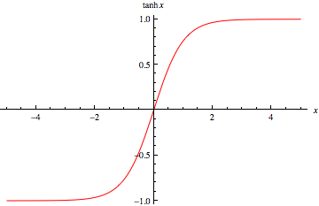
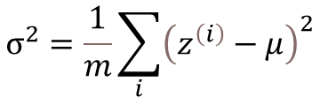
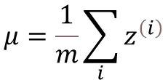
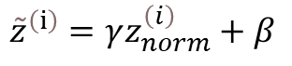
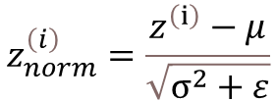
Batch normalization
Normalize:
$$μ=\frac{1}{m}\sum_{i}{z^{\left(i\right)}}$$
$$σ^{2}=\frac{1}{m}\sum_{i}{{\left(z^{\left(i\right)}−μ\right)}^{2}}$$
$$z_{norm}^{\left(i\right)}=\frac{z^{\left(ⅈ\right)}−μ}{\sqrt{σ^{2}+ε}}$$
Allow the network to modify the range
$${\tilde{z}}^{\left(ⅈ\right)}=γz_{norm}^{\left(i\right)}+β$$

Slide 38
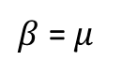
Batch normalization
Normalize:
$$μ=\frac{1}{m}\sum_{i}{z^{\left(i\right)}}$$
$$σ^{2}=\frac{1}{m}\sum_{i}{{\left(z^{\left(i\right)}−μ\right)}^{2}}$$
$$z_{norm}^{\left(i\right)}=\frac{z^{\left(ⅈ\right)}−μ}{\sqrt{σ^{2}+ε}}$$
Allow the network to modify the range
$${\tilde{z}}^{\left(ⅈ\right)}=γz_{norm}^{\left(i\right)}+β$$
Can learn the identity function
$$γ=\sqrt{σ^{2}}$$
$β$ = $μ$

Slide 39
Batch normalization at test time
We cannot compute the mean and standard deviation on a batch of samples
Instead we use a static mean and standard deviation were computed empirically during training
Compute the mean and standard deviation on the entire training set
Estimate the mean and standard deviation using exponential weighted averages

Slide 40
Batch normalization (advantages)
Reduces the dependence on weights initialization
Improves gradient flow through the network
Slight regularization effect

Slide 41
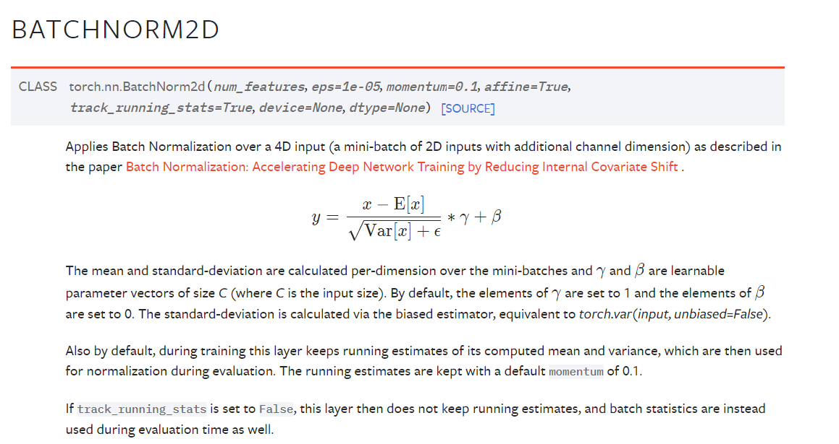
Batch normalization in pytorch

Slide 42
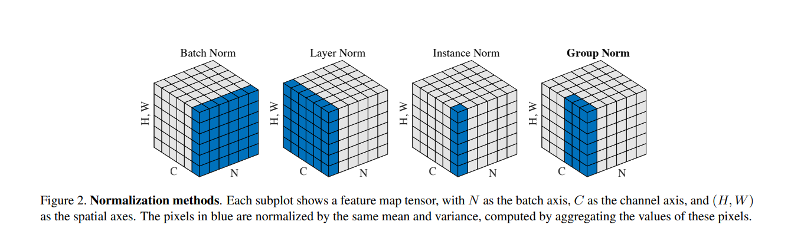
Other normalization methods
https://arxiv.org/pdf/1803.08494.pdf

Slide 43
Training a neural network
Regularization

Slide 44
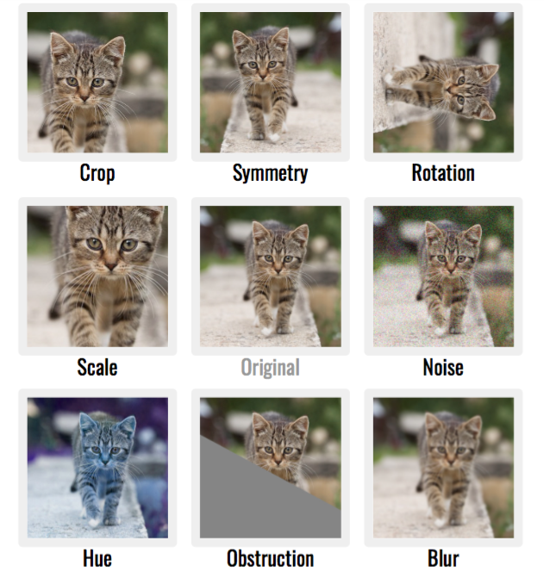
Data augmentation
Image source: https://mc.ai/easy-way-to-improve-image-classifier-performancepart-1%E2%80%8A-%E2%80%8Amixup-augmentation-with-codes-2/

Slide 45
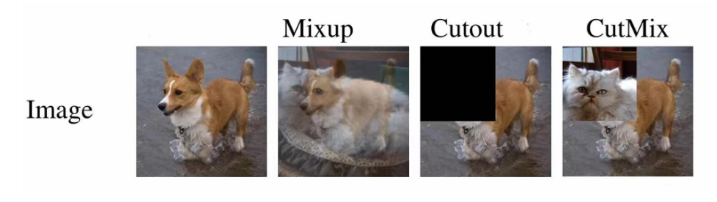
Data augmentation

Slide 46
Regularization
Remember regularization techniques
L1 regularization
L2 regularization

Slide 47
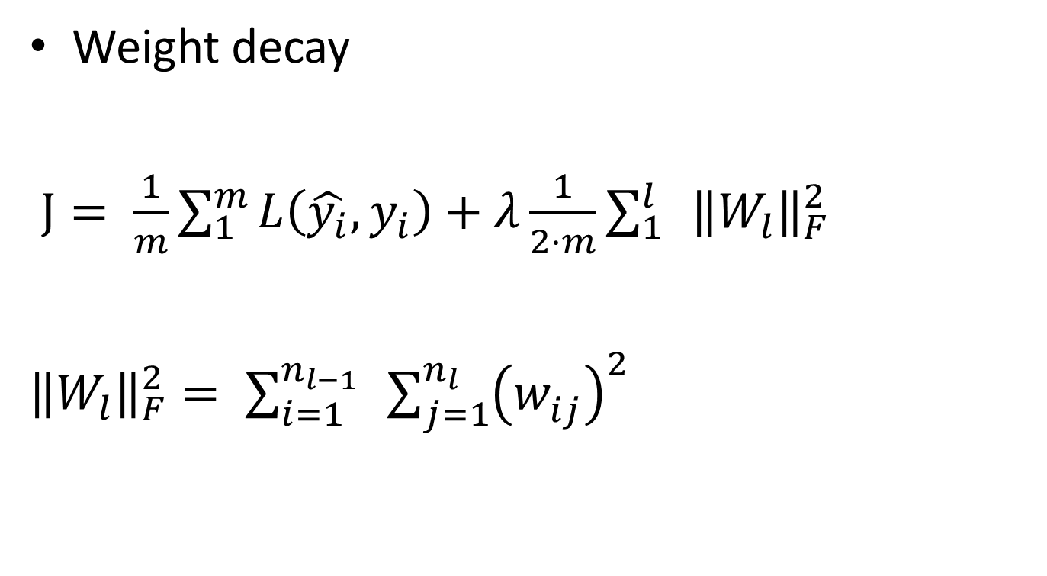
Regularization
Weight decay
$J= \frac{1}{m}\sum_{1}^{m}{L\left(\hat{y_{i}}, y_{i}\right)+λ\frac{1}{2⋅m}{\sum_{1}^{l}{ }{\left\|W_{l}\right\|}_{F}^{2}}^{ }}$
${\left\|W_{l}\right\|}_{F}^{2}= \sum_{i=1}^{n_{l−1}}{ }\sum_{j=1}^{n_{l}}{{\left(w_{ij}^{ }\right)}^{2}}$

Slide 48
Dropout

Slide 49
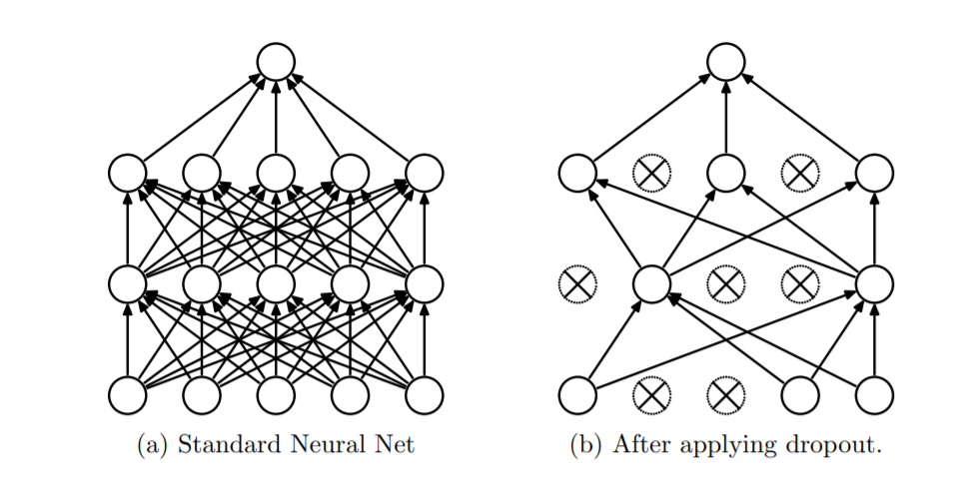
Dropout (2014)
Randomly drop units (and their connections) from the neural network during training
SRIVASTAVA, Nitish, et al. Dropout: a simple way to prevent neural networks from overfitting. The journal of machine learning research, 2014, 15.1: 1929-1958.
https://jmlr.org/papers/volume15/srivastava14a/srivastava14a.pdf

Slide 50
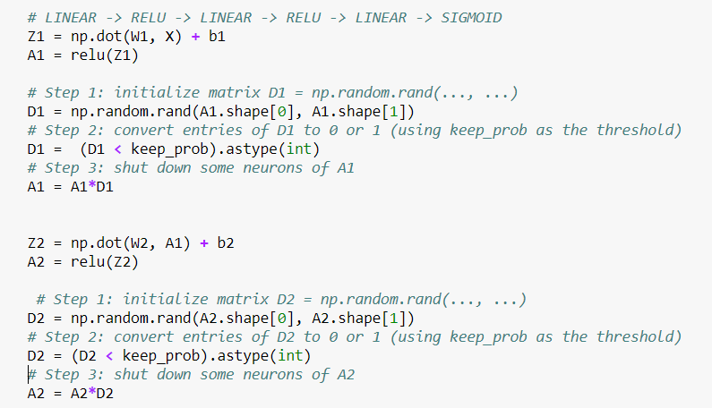
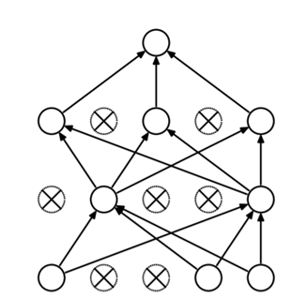
Dropout
keep_prop – probability of keeping a neuron; larger value, less dropout

Slide 51
Dropout visualization
Video source: https://www.coursera.org/learn/deep-neural-network/ungradedLab/xioPP/lab

Slide 52
Dropout intuition
At each iteration you actually modify your model:
train a different model that uses only a subset of your neurons
neurons thus become less sensitive to the activation of one other specific neuron (others neuron might be shut down at any time)

Slide 53
Dropout intuition
Train a large ensemble of models (with shared parameters)
Forces the model to have a redundant representation

Slide 54
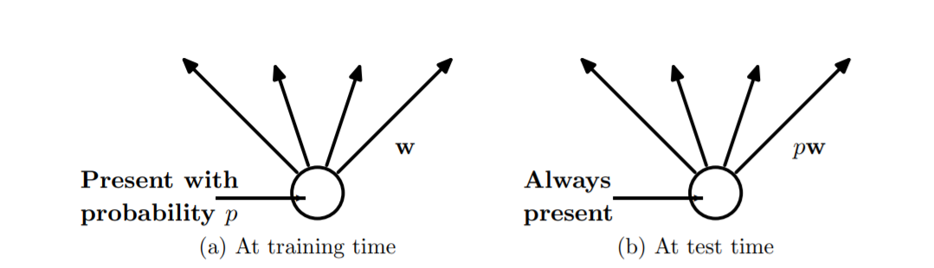
Dropout at test time

Slide 55
Dropout at test time
The neurons are always turned on
Scale the activation for each neuron
output at test time = expected output at training time

Slide 56
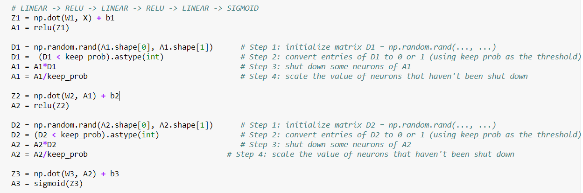
Dropout at test time
keep_prop – probability of keeping a neuron; larger value, less dropout

Slide 57
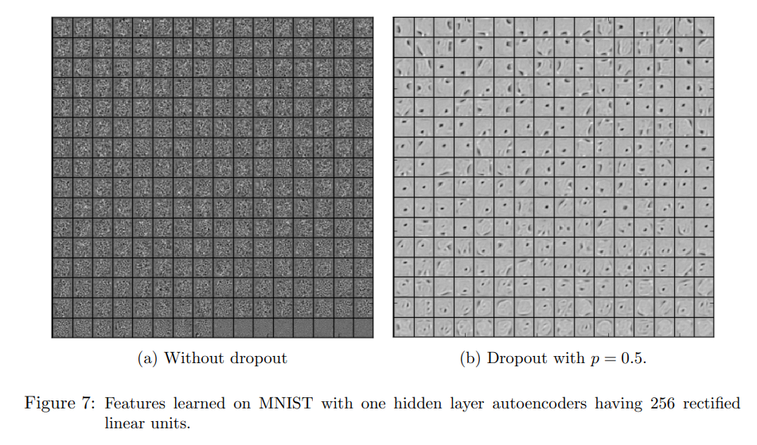
Dropout in practice
A hidden unit cannot rely on other specific units to correct its mistakes. It must perform well in a wide variety of different contexts provided by the other hidden units.

Slide 58
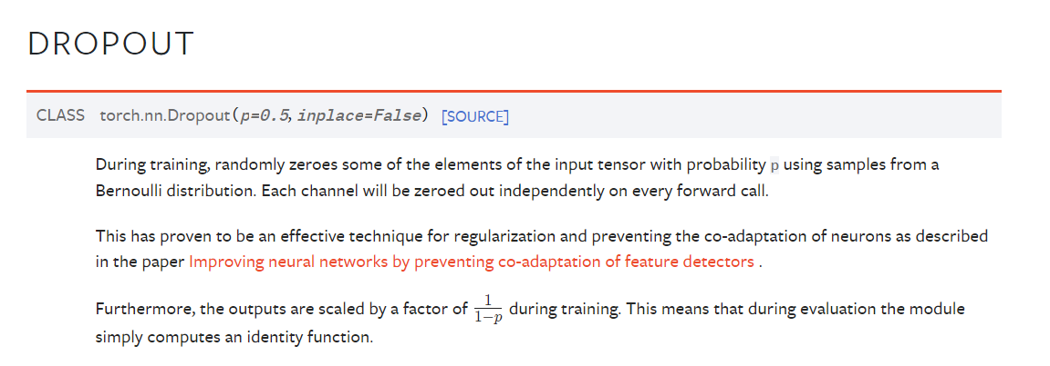
Dropout in torch

Slide 59
Training a neural network
Optimization algorithms

Slide 60
Parameters update – gradient descent
Vanilla gradient descent:
Forward propagation through the network
Compute loss
Back-propagate to compute gradients
Update the parameters using the gradient

Slide 61
Parameters update – gradient descent
Batch gradient descent
“classical” implementation of gradient descent
Use vectorization and process the entire training set at the same time
Split the training set into mini-batches

Slide 62
Parameters update – gradient descent
“Classical” gradient descent
Use vectorization and process the entire training set at the same time
Split the training set into mini-batches
while True:
batch = sample_batch(data) W_gradient = compute_gradient(loss_func, batch, W) # update parameters W += -lr*W_gradient

Slide 63
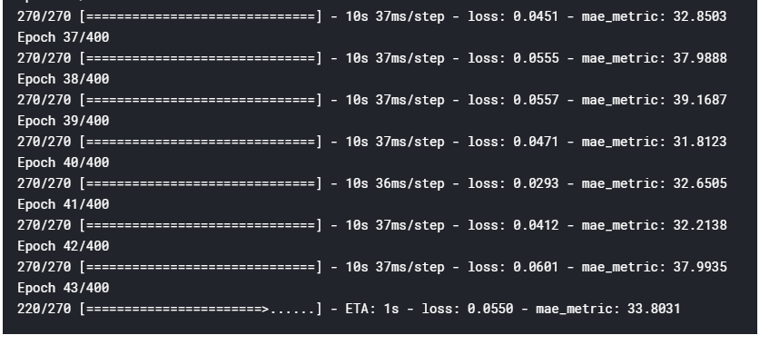
Mini-batch gradient descent
Epoch: single pass through the entire training set

Slide 64

Size of the mini-batches
Stochastic gradient descent (m=1)
Mini-batch gradient descent
Batch gradient descent (m = M)

Slide 65
Size of the mini-batches
Stochastic gradient descent (m=1)
no vectorization, lose speedup
Mini-batch gradient descent
Fastest learning: use vectorization and doesn’t take top much time to update the weights
2⁶ , 2⁷ , …, 2¹⁰
Batch gradient descent (m = M)
Too much time per iteration

Slide 66
Parameters update – mini-batch gradient descent
foreach batch t:
Forward propagation through the network
Compute loss
Backpropagate to compute gradients
Update the parameters using the gradient

Slide 67

Level sets of a surface
https://mathinsight.org/level_sets

Slide 68

Problems with gradient descent
What if loss changes abruptly on one direction and slower in the other direction?

Slide 69
Problems with gradient descent
What if loss changes abruptly on one direction and slower in the other direction?

Slide 70
Problems with gradient descent
What if loss changes abruptly on one direction and slower in the other direction?
Small gradient horizontally
Large gradient vertically
Slow progress along the horizontal direction, jitter along the vertical direction (the steeper one)

Slide 71
Gradient descent with momentum
Compute an exponentially weighted average of the gradients and use this average to update the parameters of the network

Slide 72


Gradient descent with momentum Update rule
Gradient descent update:
$$W=W −α⋅dW$$
Momentum update:
$$v_{dW}= β⋅v_{dW}+\left(1−β\right)⋅dW$$
$$W=W −α⋅v_{dW}$$
$β$– hyper-parameter; common value 0.9

Slide 73
Gradient descent with momentum
Take more straightforward part (damp oscillations)
Slower learning vertically, faster learning horizontally

Slide 74

Gradient descent with momentum
Intuition
Ball rolling down the loss function with friction
Gradient: the force the ball is feeling (F = ma)
$$v_{dW}= β⋅v_{dW}+\left(1−β\right)⋅dW$$
$β$ – friction
Hyper-parameter
velocity
acceleration
Shallow, consistent direction: build up the velocity across the dimension
Steep direction: attenuate velocity (quickly changing sign); oscillate to the “middle”

Slide 75

Gradient descent with momentum Update rule - variant
$$v_{dW}= β⋅v_{dW}+\left(1−β\right)dW$$
$$v_{dW}= β⋅v_{dW}+dW$$
$$W=W −α⋅v_{dW}$$
$β$– hyper-parameter; common value 0.9

Slide 76




Nesterov momentum
$$v_{dW}= β⋅v_{dW}+dW$$
Image source: https://cs231n.github.io/neural-networks-3/#sgd
https://dominikschmidt.xyz/nesterov-momentum/

Slide 77

AdaGrad
$$cache+=dW^{2}$$
$$W=W−α⋅dW/(\sqrt{cache}+1e^{−7})$$
cache – same size as W
Element wise scaling of the gradient based on the “historical” sum of squares in each dimension
Per parameter adaptive learning rate

Slide 78

AdaGrad
$$cache+=dW^{2}$$
$$W=W−α⋅dW/(\sqrt{cache}+1e^{−7})$$
Equalizing effect
Larger learning rate on “shallow” directions than on steeper directions

Slide 79


RMSProp
$$cache+=dW^{2}$$
$$W=W−α⋅dW/(\sqrt{cache}+1e^{−7})$$
Adagrad
$$cache=β_{2}⋅cache+\left(1 −β_{2}\right)⋅dW^{2}$$
$$W=W−α⋅dW/(\sqrt{cache}+1e^{−7})$$
RMSProp
Introduced by Geoffrey Hinton on a lecture on Coursera:

Slide 80



Adam
Combine RMSProp with momentum
$$m=β_{1}⋅m+\left(1 −β_{1}\right)⋅dW$$
$$v=β_{2}⋅v+\left(1 −β_{2}\right)⋅dW^{2}$$
$$W=W−α⋅m/(\sqrt{v}+1e^{−7})$$
momentum
(velocity)
RMSProp like
RMSProp
$$cache=β_{2}⋅cache+\left(1 −β_{2}\right)⋅dW^{2}$$
$$W=W−α⋅dW/(\sqrt{cache}+1e^{−7})$$

Slide 81
Adam
Combine RMSProp with momentum
$$m=β_{1}⋅m+\left(1 −β_{1}\right)⋅dW$$
$$v=β_{2}⋅v+\left(1 −β_{2}\right)⋅dW^{2}$$
$$W=W−α⋅m/(\sqrt{v}+1e^{−7})$$
momentum
(velocity)
RMSProp like
RMSProp
$$cache=β_{2}⋅cache+\left(1 −β_{2}\right)⋅dW^{2}$$
$$W=W−α⋅dW/(\sqrt{cache}+1e^{−7})$$
Noisy gradients

Slide 82



Adam
Combine RMSProp with momentum
for t in range(0, iterations):
$$m=β_{1}⋅m+\left(1 −β_{1}\right)⋅dW$$
$$v=β_{2}⋅v+\left(1 −β_{2}\right)⋅dW^{2}$$
$$m=m/(1 −β_{1}^{t})$$
$$v=v/(1 −β_{2}^{t})$$
Bias correction
$$W=−α⋅m/(\sqrt{v}+1e^{−7})$$

Slide 83

http://www.denizyuret.com/2015/03/alec-radfords-animations-for.html

Slide 84

Optimization algorithms
https://awesomeopensource.com/project/3springs/viz_torch_optim

Slide 85

Optimizers in torch

Slide 86
Training a neural network
Learning rate scheduling

Slide 87

Learning rate

Slide 88


Learning rate decay
Learning rate decay over time!
Use a larger learning rate at the beginning and progressively reduce the learning rate
t epoch, k – decay rate
Step decay:
reduce learning rate by half after some epochs
Exponential decay
1/t decay
$$α=α_{0}⋅e^{−kt}$$
$$α=α_{0}/ (1+kt)$$

Slide 89
Optional additional reading
https://ruder.io/optimizing-gradient-descent/index.html#otherrecentoptimizers
https://www.youtube.com/watch?v=k8fTYJPd3_I
https://www.youtube.com/watch?v=_e-LFe_igno
https://www.coursera.org/lecture/deep-neural-network/the-problem-of-local-optima-RFANA

